Slide 1
16 Key Concepts
Proposed, constructed, revised by David Webber since 1975.

Slide 2
1. Democracy and Alternative Perspectives of Democracy
2. Political Science
3. public policy
4. policy analysis
5. policy making is problem solving
6. describe, explain, evaluate, advocate
7. normative, empirical, prescriptive, and causal statements
8. process evaluation vs. product evaluation
9. public goods, private goods, common pool resource

Slide 3
10. tragedy of the commons
11. federalism
12. general explanations, theories and models
13. levels of analysis
14. systems model
15. personal, political, economic, legal, moral
arguments (or reasons) vs. policy argument (or reason).
16. politics shapes policy; policy motivates politics

Slide 4
1. Democracy and Alternative Perspectives of Democracy
민주주의와 민주주의의 대안 관점
2. Political Science
정치학
3. Public Policy
공공 정책
4. Policy Analysis
정책분석
5. Policy Making is Problem Solving
정책 결정은 문제해결

Slide 5
6. Describe, Explain, Evaluate compared to Advocate
서술, 설명, 평가, 그리고 주장 구분
7. Normative ,Empirical, Prescriptive Statements compared to Causal Statements
규범적 분석, 실험적, 처방적 진술과 인과적 진술 구분
8. Process Evaluation vs. Product Evaluation
과정 평가와 결과 평가
9. Public Goods vs. Private Goods vs. Common Pool Resources
공공재, 사유재, 공유재 구분
10 Tragedy of the Commons
공유지의 비극- 개인의 이익과 공공의 이익 사이의 갈등

Slide 6
11. Federalism
연방주의(idea) , 연방제(system)
12. General Explanations, Theories, and Models
일반적 설명, 이론, 그리고 모델
13. Levels of Analysis
분석의 단위
14. Systems Model
체계 모델
15. Personal, Political, Legal, Economic, Moral and Policy Arguments (or Reasons)
개별적, 정치적, 합법적, 경제적, 도덕적, 그리고 정책적 주장(이유)
16. Politics shapes Policy ; Policy motivates Politics
정치가 정책을 만든다 ; 정책이 정치를 만든다..

Slide 7
1. Democracy and Alternative Perspectives of Democracy
Democracy—”rule of the people.”
“We, the people, . . .” (preamble to U.S. Constitution.)

Slide 8
Defining democracy is easy
Democracy—”rule of the people.”
From Greek “demos” means “people”
“cracy” means “rule.
“We, the people, . . .”
What’s the best known description of democracy?

Slide 9
What’s the best known description of democracy?
“a government
  of the people,
  by the people, and
  and for the people.”
  President Abraham Lincoln, “Gettysburg Address” November 19, 1863.

Slide 10
Universal Declaration of Human Rights sounds like “democracy”
Article 21.
(1) Everyone has the right to take part in the government of his country, directly or through freely chosen representatives.
(2) Everyone has the right of equal access to public service in his country.
(3) The will of the people shall be the basis of the authority of government; this will shall be expressed in periodic and genuine elections which shall be by universal and equal suffrage and shall be held by secret vote or by equivalent free voting procedures.

Slide 11
International Day of Democracy
September 15 (since 2007)
http://www.ipu.org/dem-e/idd/overview.htm

Slide 12
Alternative Perspectives of Democracy
WHO should be involved?
-all citizens?
- only informed, well educated citizens?
HOW should they be involved?
-participatory democracy
-representative democracy

Slide 13
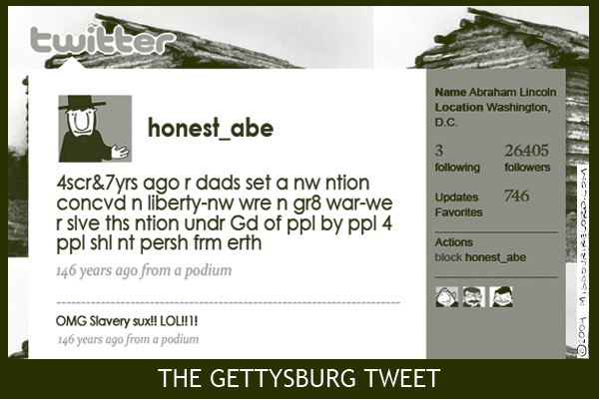
Most popular notion of Democracy

Slide 14
Alternative interpretations of democracy
Two sets of traditional political science interpretations--the who and the how
I. Who
1. elitist--Hamilton--
2. pluralist--Madison
3. direct (or classical)—Jefferson
Also Tocqueville --”Americans are joiners” he wrote in his observations about associations. He wrote “there is hardly a cause for which there is not some association in America.”
New England town meetings are much different than the U.S. Senate

Slide 15
Democracy (continued)
II. The How
A. Representative—elect people to represent us
Traditional political science questions:
1. Should representatives be delegates vs. trustees? (Normative)
2. Who SHOULD elected officials to represent? (Normative)
3. Who DO elected officials represent?
(Empirical)
B. Participatory—direct involvement of citizens

Slide 16
Democratic results?
The WHAT
  Public policies should conform to public preferences over the long run.

Slide 17
Government OF the People and BY the people relates to the PROCESS of policy-making
Government FOR the people relates to the PRODUCT of policy-making

Slide 18
2. What is Political Science?
Political science is the study of governments, public policies and political processes, political systems, and political behavior.
Political Science focuses on collective decisions, how individuals affect collective decisions, and the causes and impacts of collective decisions.

Slide 19
Subfields of Political Science
Political science subfields include
-political theory and philosophy,
-political economy,
-policy studies and analysis,
-comparative politics,
-international relations,
but rely and use many related fields (e.g. economics, history, geography, sociology, etc).

Slide 20
What the difference between a republic and a democracy?
(It is the difference between Latin and Greek– Madison started this confusion in Federalist #10).

Slide 21
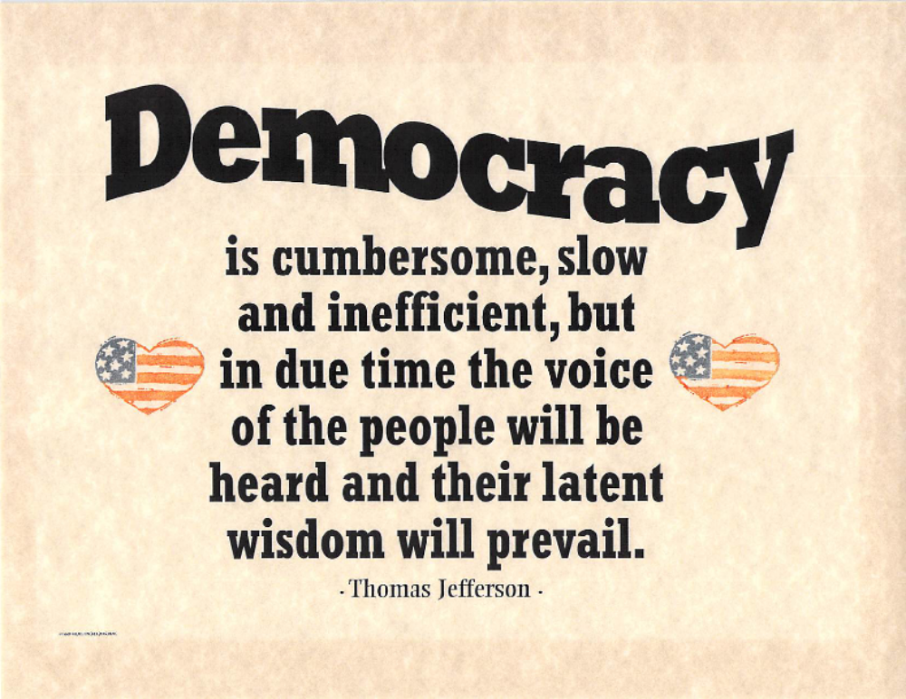
Jefferson Quote on my Office Wall

Slide 22
Jefferson plaque in my office:
“Democracy is cumbersome, slow and inefficient, but in due time the voice of the people will be heard and their latent wisdom will prevail.”

Slide 23
Rotunda of Missouri Capitol
In proportion as the structure of a government gives force to public opinion, it is essential that public opinion should be enlightened.
Source: President George Washington’s Farewell Address, 1796

Slide 24
Political Science
Political Science relies on journalism, people’s opinions, history and sociology but we look for evidence and support, not just opinions.
Political Science focuses on the social and political institutions that develop to make collective decisions.

Slide 25
3. Public Policy
--"official decisions of governments." What governmental officials decide to do or not to do;
--all of the laws, treaties, regulations, court decisions, legislation, executive decisions, administrative decisions made by government.

Slide 26
4. Policy analysis
"use of reason and evidence to select the best alternative to solve an issue of public concern"
Source: MacRae and Wilde, POLICY ANALYSIS FOR PUBLIC DECISIONS
“analysis” excludes force, ideological thinking, non-thinking (e.g. habits), chance.

Slide 27
5. Policy making is problem solving
problem—gap between the ideal and the actual
problem definition is political
“problem coping” rather than “problem solving”
Problem solving is usually reactive, not anticipatory

Slide 28
6. Describe, explain, evaluate vs. advocate
Policy analysis involves:
1. Describe –to give essential characteristics
2. Explain—to present a cause and effect relationship, to give reasons for
3. Evaluate-to compare the actual with the ideal
The “ideal” in policy analysis is “broad social values” not personal self interest.
Advocate- to promote, to lobby, to aggressively recommend.
Rhetoric is seldom policy analysis, it is usually emotion-based persuasion.

Slide 29
7. Normative vs. empirical, causal and prescriptive analysis/statements
Classic distinction is that of David Hume’s “ought” vs. “is.”
Also:
“ideal” vs. “real”
“value” vs. “fact.”
Empirical statements are true or false, normative statements are agreed to or disagreed with.
Predictions are empirical statements about the future, not normative.
Be careful about “predictive ought” (e.g. “it ought to rain”) and “false inflammatory facts” (e.g. “students are lazy”).

Slide 30
7a. Causal and Prescriptive
There are also
Causal statements—assert an “if, then” statement, e.g. if practice scales, then better guitar player
Prescriptive statements– usually a conclusion, proposing a desirable course of action, e.g. Therefore, you should take your umbrella.

Slide 31
8. process evaluation vs. product evaluation
Judging the process vs. judging the outcome.
Process evaluation criteria:
  Open, fair, constitutional, legitimate, informed.
  Product evaluation criteria:
  Solve the problem (effective), economic impact, reading ability, change in health,

Slide 32
9. public goods vs. private goods compared to Common Pool Resource
Public good—effects are not easily controlled so its hard to exclude others from using the good once it is provided.
(non-excludability and non-rivalness are the buzz terms)
Private goods--easy to keep non-providers from using.
This distinction is about physical properties not legal ownership.
Implication: market doesn’t work for public goods

Slide 33
Common Pool Resource (CPR)
CPR– a shared resource where your use DOES affect me.
There is not rivalness but it is hard to exclude others.

Slide 34
10. tragedy of the commons
Shared resource permits easy overuse by self-interested individuals
aka CPR (“Common Pool Resource”) –not the same as a public good—but related.
The title of a classic article by Garret Hardin Science 1968.
Professor Elinor Ostrom (of Indiana University) won the Nobel Prize in Economics 2009 for her work on GOVERING THE COMMONS

Slide 35
11. Federalism
Fact: we have at least 89, 527 governmental jurisdictions in the U.S.
Madison used the term “compound republic.”
My definition: a system of independent yet interdependent levels of government.
Our language causes problems: be careful about “centralized” vs. “decentralized.” Federalism is about policy making responsibility not administrative organization.

Slide 36
89, 527 jurisdictions
Nation 1
States 50
Counties 3,003
Municipalities 19,492
Townships and towns 16,519
School districts 13,051
Special districts 37,381
Total 89,527

Slide 37
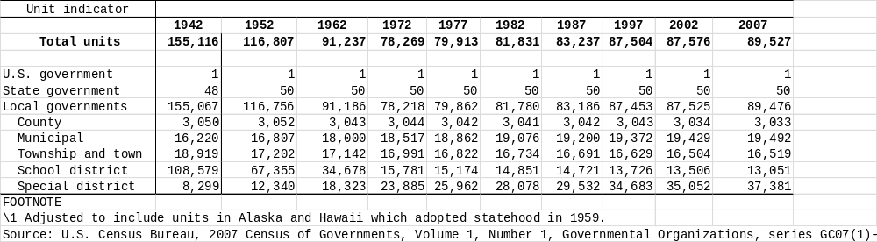

Slide 38
Advantages and disadvantages of federalism.
Advantages:
1. prevent centralization of political power
2. allow for experimentation--states as laboratories of democracy
3. allow for flexibility
4. more response to local needs
Disadvantages
1. add to cost and time of decision-making
2. allow for disparities and inequities among the states, e.g. death penalty, quality of education

Slide 39
Alternative ways to assign policy making responsibility
1. Constitutional reasoning: examine Art 1, section 8 (17 fairly specific powers plus the “necessary and proper” clause,” Art I, sec 10 (prohibit states), Art. IV (“full faith and credit,” and “privileges and immunities” and Amendment X (“reserved powers”) of U.S. constitution and argue that the national government does or does not have jurisdiction over guns.
2. Analytical reasoning: the optimal jurisdiction is that receiving costs and benefits of a policy decision. Local problems should be addressed by local government; more widely distributed problems should be dealt with by state or national government.
3. Political reasoning: three levels of governments can do whatever they are on. e.g. emergency assistance (FEMA), federal funds for local projects. Perhaps federal assistance for first-responders and homeland security is another example.

Slide 40
Woodrow Wilson is right
Richard Nathan, “Updating Theories of American Federalism”
Conclusion:
Woodrow Wilson was right: “The federal-state relationship is the cardinal question of our constitutional system. It cannot be settled by the opinion of any one generation, because it is a question of growth, and every new successive state of our political and economic development gives it a new aspect, makes it a new question.”
(from: Constitutional Government in the United States).

Slide 41
12. General explanations, theories and models
Goal of social science is to propose and support law-like explanations of social phenomenon.
A “theory” is a well-formulated if, then statement.
A model is a simplification of reality that describes and explains an important behavior or event.
A hypothesis is a testable prediction based on a theory.

Slide 42
13. Levels of analysis
The perspective from which you view an action or event.
Textbook metaphor is zoom camera
Typical levels in political science:
1. Systemic
2. Institutional
3. Individual.

Slide 43
14. Systems model
Models are simplifications of reality, abstraction, metaphors used to increase understanding.
Systems models—inputs flowing through some process yielding outputs/outcomes.

Slide 44
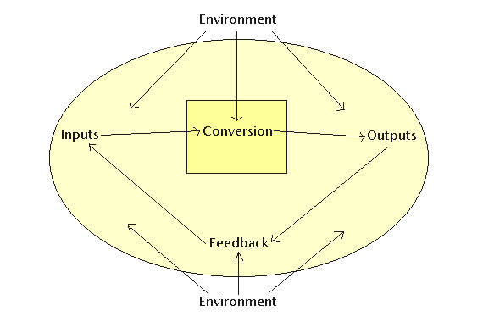
A very general diagram of a systems model (but without impacts)

Slide 45
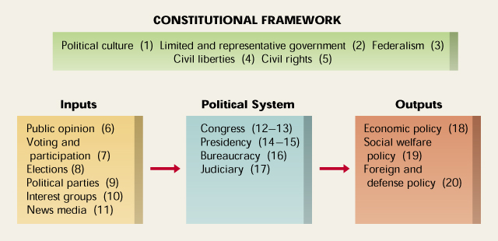
Simple systems model of U.S. National government

Slide 47
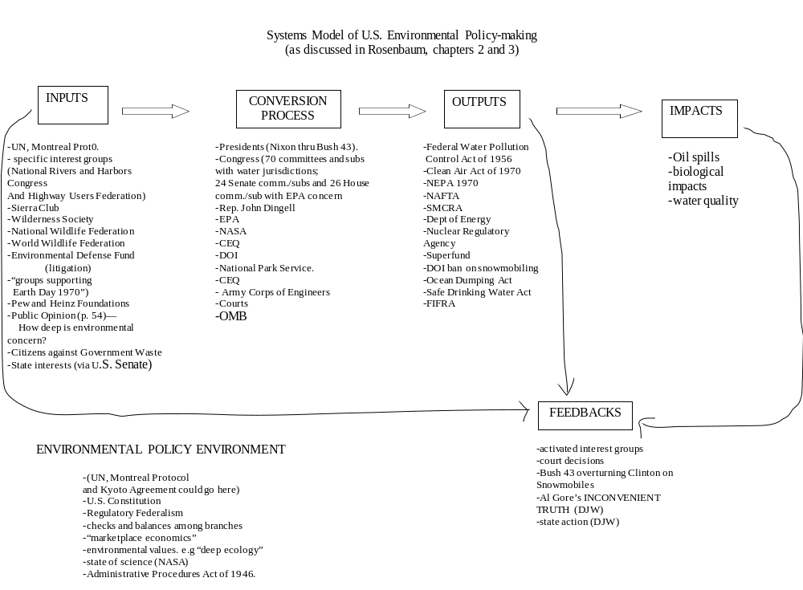

Slide 48
15. Personal, economic, political, legal and moral arguments vs. policy arguments.
Policy analysis examines the impact of a proposed alternative and asks “is it best for society?”
Policy makers use all kinds of information and cues to make policy decisions. Sometimes they use policy analysis. Most of the time they use other information.
Policy analysis includes economic, legal, political, and moral considerations but is not solely those types of arguments.

Slide 49
16. Politics shapes policy; policy motivates politics
Politics affects policy decisions. Who is involved, what they do, decisions they make largely determines the kinds of public policies we get. Often, if you change the process, you change the policy outcome.
Policy, however, motivates interests to get involved in politics (aka policymaking). Proposed policy changes activate certain interests in society.

Slide 50
If 17, Three logics of Policy Subsystem policy-making
Policy Logic—how would the proposed policy alternative work?
2. Internal Political Logic- administrators’ and legislators’ views, especially leadership, committees, caucus, president, policy networks.
3. External Political Logic - public opinion, other executive agencies

